Slide 1


Cloud Native Manchester April 2026
6PM: Networking with food and drinks
7PM: DBOS: making reliable cloud workflows - Afzal Muhammad
Break!
8PM: Agents, Kubernetes, and Tailscale: What My Home Lab Looks Like in 2026 - Thomas Riley
Sponsored by
Morson-Edge & Nscale

Slide 2
Please take your seats
Getting started in a few moments!
6PM: Networking with food and drinks
7PM: DBOS: making reliable cloud workflows - Afzal Muhammad
Break!
8PM: Agents, Kubernetes, and Tailscale: What My Home Lab Looks Like in 2026 - Thomas Riley

Slide 3
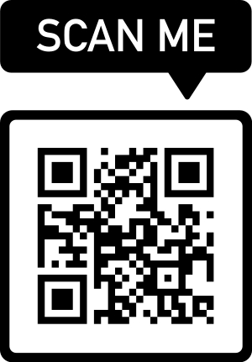
Announcements
Official CNCF meetup now, please “mark attendance” there:
https://community.cncf.io/cloud-native-manchester/
Future Manchester meetups:
June 17th @ Booking.com Office
September 17th @ Booking.com Office
Sponsors and talks needed so please reach out via contact@cloudnativemcr.co.uk or http://cloudnativemcr.co.uk/
Cloud Native Slack #manchester channel @ https://cloud-native.slack.com/archives/CJA8M2HCJ

Slide 4
Sponsor: Morson Edge
https://morson-edge.com/
Thank you to Morson Edge for kindly sponsoring todays event.
Thank you for hosting us this evening at Bonded Warehouse once again.
Notes:
Lloyd Lowson

Slide 5
Sponsor: Nscale
https://nscale.com
Thank you to Nscale for kindly sponsoring todays event.
They are hiring @ https://www.nscale.com/careers
Notes:
Simon Murray

Slide 6
Agenda
6PM: Networking with food and drinks
7PM: DBOS: making reliable cloud workflows - Afzal Muhammad
Break!
~8PM: Agents, Kubernetes, and Tailscale: What My Home Lab Looks Like in 2026 - Thomas Riley

Slide 7
DBOS: making reliable cloud workflows
Afzal Muhammad

Slide 8
Second talk starting at 8PM
Sponsored by
Morson-Edge & Nscale

Slide 9
Please take your seats
Getting started in a few moments!

Slide 10
Agents, Kubernetes, and Tailscale: What My Home Lab Looks Like in 2026
Thomas Riley

Slide 11
See you next time
Sponsors and talks needed so please reach out:
contact@cloudnativemcr.co.uk OR http://cloudnativemcr.co.uk/
Please register on the CNCF site:
https://community.cncf.io/cloud-native-manchester/
CNCF Slack: https://cloud-native.slack.com/archives/CJA8M2HCJ
Next Manchester meetup: June 17th @ Booking.com Office

